Slide 1
Security Awareness
Program v2
Waquis PVT LTD
2022/2023

Slide 2
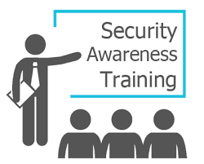
Purpose of this Presentation
Welcome employee to the presentation!
Purpose is to increase awareness and promote responsible information security practices.
Agenda
Data Classification,
Password Management,
Phishing Awareness,
Social Engineering, etc

Slide 3
Ransomware Attack Awareness.
Scenario:
You receive an email with an attachment from an unknown sender, claiming to be an invoice for an urgent payment. The email asks you to open the attachment.
Test Question:
What should you do when you receive such an email, and why?
Answer:
Do not open the attachment or click any links. Contact the IT department or your manager to verify the email's authenticity. Ransomware attacks can be initiated through malicious attachments or links, and opening them can result in data encryption and financial losses.

Slide 4
Phishing Attack Awareness.
Scenario:
You receive an email that appears to be from a colleague, asking you to click a link to access an important document. The email has a sense of urgency.
Test Question:
How can you determine if this email is potentially a phishing attempt, and what should you do?
Answer:
Check the sender's email address for any irregularities or slight misspellings. Hover over the link without clicking to see where it leads. Confirm with your colleague through another communication channel if they indeed sent the email. Phishing emails often impersonate trusted contacts and may contain deceptive links.

Slide 5
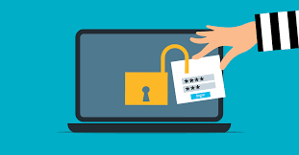
Password Management
Characteristics of a Strong Password:
Explain the characteristics of a strong password, use the example following:
"A strong password might be something like 'P@ssw0rd!2,' which includes uppercase and lowercase letters,
numbers, and special characters.“
Break down the example: "P@ssw0rd!2" includes:
Uppercase and lowercase letters (mixed case): 'P' and 'p'
Numbers: '0' and '2'
Special characters: '@' and '!'
It's at least 8 characters long.

Slide 6
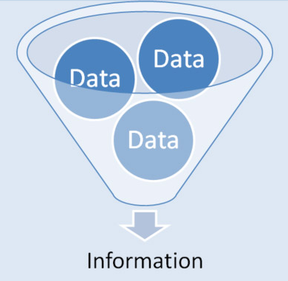
What is information?
Information is an asset which, like other important business assets, has value to an organization and consequently needs to be suitably protected.
Is Information and Data different?
Information refers to facts concerning a particular event or subject, which are refined by processing. Data are simple text and numbers, while information is processed and interpreted data. Data is in an unorganized form

Slide 7
SECURITY ELEMENTS
PEOPLE
Staff, Contractors, Management
PROCESSES
Business activities
TECHNOLOGY
Internet, mobile smart devices, etc.
People who use or have an interest in our information security include:
Shareholders / owners
Management & staff
Customers / clients, suppliers & business partners
Service providers, contractors, consultants & advisors
Authorities, regulators & judges
Our biggest threats arise from people, yet our biggest asset is our people
Processes are work practices or workflows, the steps or activities needed to accomplish business objectives.
Processes are described in procedures.
Virtually all business processes involve and/or depend on information making information a critical business asset.
Information security policies and procedures define how we secure information appropriately and repeatedly.
Information Security
Information Technologies:
Cabling, data/voice network equipment, Telecommunication services
Phone, cellphones, PDAs, Operating system, application software, FTP
Security Technologies:
Locks, barriers, CCTV, card-access systems

Slide 8
Questions and Discussion?
Thank You !

